Slide 1
Hibernate Annotations
A simple way to map entities without XML

Slide 2
Hibernate Annotations
Annotations allow you to map entities and their relationships without xml files.
All the mapping information will be in the code for each domain object

Slide 3
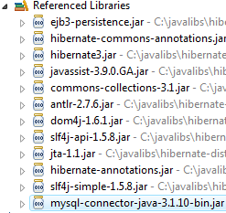
Required Libraries

Slide 4
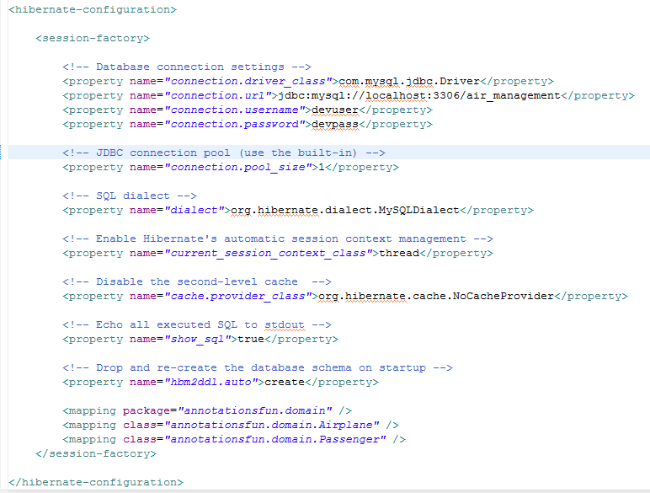
Configuration File (hibernate.cfg.xml)
Just specify the classes

Slide 5
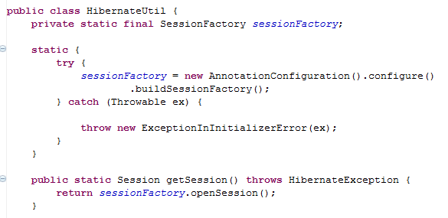
HibernateUtil
Annotation configuration

Slide 6
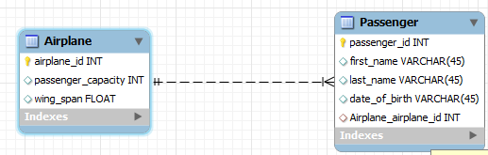
Entity Mapping!

Slide 7
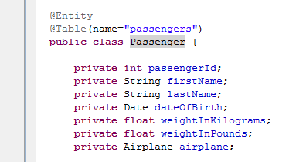
Mapping Entities to Tables
Optional!!

Slide 8
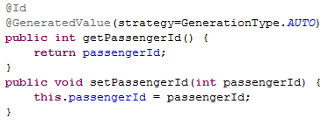
Mapping IDs

Slide 9

Mapping Columns
Optional!

Slide 10

Transient
Transient properties will be ignored (not saved to the database)

Slide 11

Properties are persisted by default!
Only property not saved to the database!

Slide 12
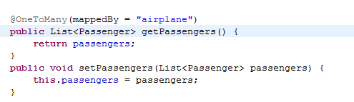
Associations (Airplane.java)

Slide 13
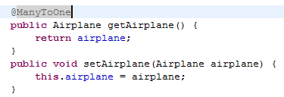
Associations (Passenger.java)

Slide 14
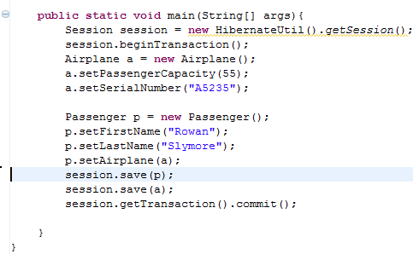
Working Associations

